Slide 1
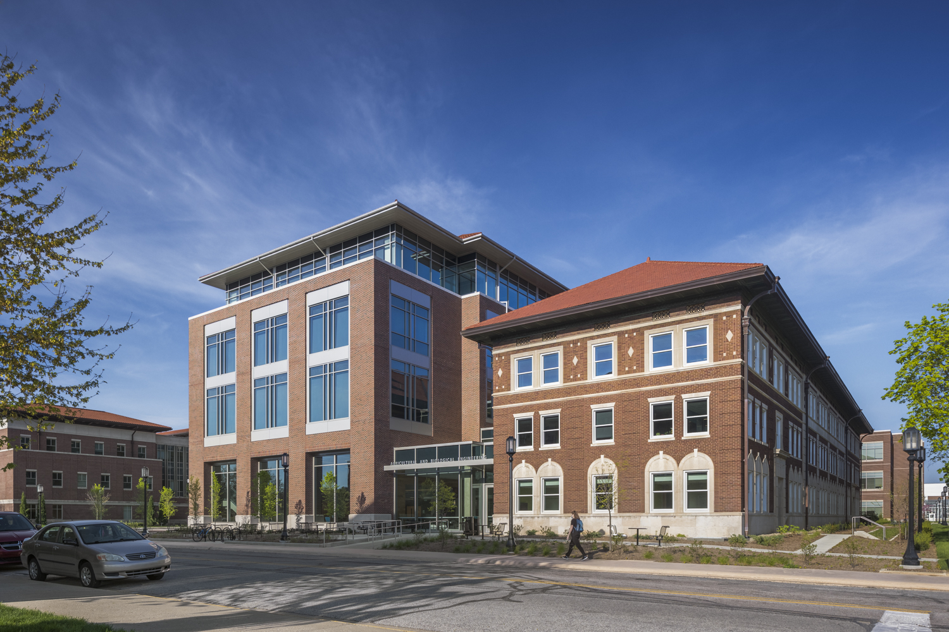
Welcome to ABE!

Slide 2
All Aboard ABE Overview
Meet the Agricultural and Biological Engineering (ABE) Undergraduate Academic Programs Staff
Review Degree Programs offered by ABE
Review the All Aboard registration process for ABE
Note upcoming events and important next steps

Slide 3
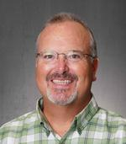
ABE Academic Programs Staff
Many of your may have met Dan on a visit to campus.
Dan assists our students in a number of ways including:
ABE Ambassador Coordinator
Student Recruitment
Scholarships
Job Search Tips and Tricks
Dan Taylor
Academic Coordinator / Assistant to the Dept. Head ABE 1033
taylordc@purdue.edu

Slide 4
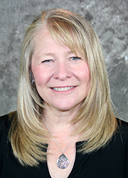
ABE Academic Programs Staff
Brenda assists our students in a number of ways including:
Internships/Co-Op Information and approval
Study Abroad Information and approvals
Curriculum Support
Graduation Audits
Brenda Schroeder
Director of Undergraduate Programs
ABE 1035
brendaschroeder@purdue.edu

Slide 5
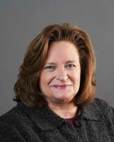
ABE Academic Programs Staff
Laurie serves as Academic Advisor for Biological Engineering Students
Additionally, Laurie coordinates the Transition to Major process and Recruitment Sessions for First Year Engineering Students (FYE)
Laurie Snyder
Senior Academic Advisor
ABE 1037
snyde158@purdue.edu

Slide 6
ABE Academic Programs Staff
Samantha serves as primary advisor for students in the following programs:
Pre-Agricultural and Biological Engineering (PABE)
Agricultural Systems Management (ASM)
Agricultural Engineering (AE)
Environmental and Natural Resources Engineering (ENRE)
Samantha Greulach
Academic Advisor
ABE 103
snyde158@purdue.edu

Slide 7
ABE Academic Programs Staff
Yvonne assists our students in a number of ways including:
Supporting Undergraduate and Graduate Programs
Publishes Weekly Newsletter
Yvonne Hardebeck
Program Coordinator
ABE 1044
hardebey@purdue.edu

Slide 8
ABE Undergraduate Degree Options
Bachelor of Science, BS
Bachelor of Science in Agricultural Engineering, BSAGE
Bachelor of Science in Biological Engineering, BSBE

Slide 9
ABE Degrees, Majors, and Concentrations
Bachelor of Science, BS
Agricultural Systems Management
With optional concentrations in
AgroSecurity
Data and Information Systems
Leadership and Management

Slide 10
ASM - Typical First Year Courses
Credits | Fall 1st Semester |  |  | Credits | Spring 1st Semester
.5 | AGR 10100 | Introduction to the College of Agriculture and Purdue University | General Chemistry I | 3 | ASM 10500 | Computing Technology With Applications | Computing Technology With Applications | General Chemistry II Or C Programming
.5 | AGR 11100 | Introduction to Agricultural and Biological Engineering Academic Programs | Transforming Ideas to Innovation I | 3 | CHM 11200 | General Chemistry II | General Chemistry II | Transforming Ideas to Innovation II
3 | ASM 10400 | Introduction to Agricultural Systems | Analytic Geometry and Calculus I | 3 | PHYS 21400 | The Nature of Physics | The Nature of Physics | Analytic Geometry and Calculus II
3 | CHM 11100 | General Chemistry I |  | 3 | AGEC 20300 or ECON 25100
3 | MA 16010 | Applied Calculus I |  | 3-4 | Written Communication Selective
3 | Human Cultures: Humanities Selective |  |  |  |  |  |  | Modern Mechanics
3 | Oral Communication Selective
16 |  |  |  | 15-16
AP/Dual credit may affect first-semester course selection. Your advisor will discuss options with you during your All Aboard registration appointment.

Slide 11
ABE Degrees, Majors, and Concentrations
Bachelor of Science in Agricultural Engineering, BSAGE*
Agricultural Engineering (Machine Systems)
Environmental and Natural Resources Engineering
*Successful completion of Pre-ABE curriculum required

Slide 12
ABE Degrees, Majors, and Concentrations
Bachelor of Science in Biological Engineering, BSBE*
Biological Engineering
With optional concentrations in
BioEnvironmental Engineering
Cellular and Biomolecular Engineering
Food and Biological Process Engineering
Pharmaceutical Process Engineering
*Successful completion of Pre-ABE curriculum required

Slide 13
ABE Degrees, Majors, and Concentrations
Pre- Agriculture and Biological Engineering (Pre-ABE)
Pre-ABE is an alternative to First-Year Engineering. The required classes are identical to First-Year Engineering requirements. Because of our ties to Agriculture, we have the ability to have engineering students join our program as freshmen.
Upon successful completion of the one-year Pre-Agricultural and Biological Engineering curriculum students can move to their professional program of choice within Agricultural and Biological Engineering.

Slide 14
Pre-ABE - Typical First Year Courses
Credits | Fall 1st Semester |  |  | Credits | Spring 1st Semester
4 | CHM 11500 | General Chemistry I | General Chemistry I | 4 | CHM 11600 or CS 15900 or CS 17700 | General Chemistry II Or C Programming | General Chemistry II Or C Programming
2 | ENGR 13100 | Transforming Ideas to Innovation I | Transforming Ideas to Innovation I | 2 | ENGR 13200 | Transforming Ideas to Innovation II | Transforming Ideas to Innovation II
4 | MA 16500 | Analytic Geometry and Calculus I | Analytic Geometry and Calculus I | 4 | MA 16600 | Analytic Geometry and Calculus II | Analytic Geometry and Calculus II
3 | Human Cultures: Humanities Selective |  |  | 4 | PHYS 17200 | Modern Mechanics | Modern Mechanics
3-4 | Written Communication Selective |  |  | 3 | Oral Communication Selective
17-18 |  |  |  | 16-17
AP/Dual credit may affect first-semester course selection. Your advisor will discuss options with you during your All Aboard registration appointment.

Slide 15
All Aboard Registration Process
ABE Advisors will be conducting Registration Appointments between June 1st and July 1st
Watch your Purdue email for an invitation to schedule your registration appointment.
Appointments will be held online via ZOOM*
Have access to a computer or laptop which will make the registration process run smoother.
Prepare for your Advising Meeting
We want to get to know YOU – be prepared to tell us a little about yourself (hobbies, interests, career goals, etc)!
Keep your list of earned/expected AP and Dual credits handy so we can discuss how/if you want to apply them to your degree. (Be sure you entered these courses on your Student Information Form!)
Prepare a list of questions for your advisor – questions can be about academics, transitioning to Purdue from high school, campus resources and opportunities, etc – don’t hesitate to ask – we’re here to help!
*If you do not have access to a computer, a phone appointment is an option, please indicate your need for an alternative meeting mode when you register for your appointment.

Slide 16
Next Steps following Registration
Enjoy high school graduation!
Complete Purdue 102 and all items on your New Student Task List.
View your finalized Fall 2024 schedule. Schedules will be available July 18th by 5 p.m.
Schedule modification may be made beginning July 22nd, but only after consultation with your advisor!
Confirm your enrollment and meet financial obligations.
Register for and attend an Orientation Program!
Come to the College of Agriculture Welcome – Friday, August 16th
Classes Begin – Monday, August 19th
Join us for the ABE Welcome Back Picnic - TBA (Early September)
Be sure to check your Purdue email regularly throughout the summer!

Slide 17
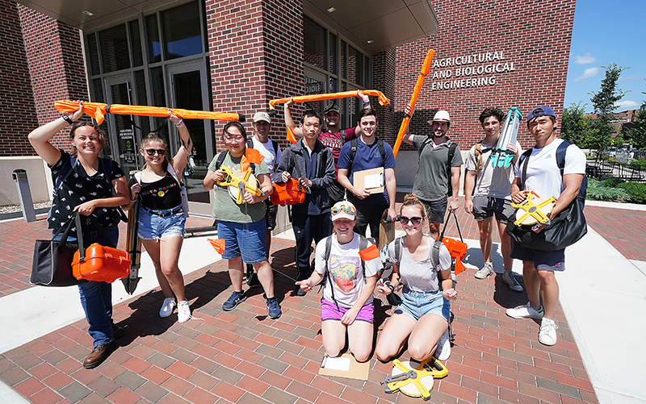
WELCOME TO ABE
We can’t wait
for you to join us this fall!
BOILER UP!

